Slide 1
GSConv-RTDETR
A simple implementation of using GSConv block with RTDETR on VisDrone dataset compared with multiple YOLOs
Yiren QIU
Ghous Iqbal

Slide 2
Agenda
1. Introduction - What is Object Detection and Object Detection from UAV Perspective
2. Domain Problem Analysis
3. Past Work: What Has Been Done and Their Deficiencies
4. Core Design of This work
5. Code Analysis Corresponding to Each Design
6. Experimental Results Comparison and Ablation Study
7. Conclusion: Recap and Emphasis on What This Paper Has Achieved

Slide 3
01.Introduction

Slide 4
Introduction
Object detection
Deep Learning
UAV
What is object detection? What are its practical applications?
The essence of deep learning technology plays a significant role in object detection tasks.
A Brief Introduction to UAVs, Their Importance, and Their Impact on Object Detection

Slide 5
Introduction
About Object Detection
Object detection is a computer vision task that aims to detect and locate objects of interest from images or videos, and identify their categories. Object detection has wide-ranging applications in numerous fields, such as security monitoring, autonomous driving, medical diagnosis, and industrial inspection.

Slide 6
Deep learning is a machine learning method based on multi-layer neural networks. Its core idea is to automatically learn features and patterns from large-scale data through data-driven and hierarchical feature representation. Unlike traditional methods, deep learning relies on multi-layer nonlinear transformations of neural networks to gradually build high-level semantic features (such as shape and object identity) from low-level features (such as edges and textures).
About Deep Learning
Introduction

Slide 7
Deep learning technology has significantly propelled the development of object detection tasks, bringing about improvements and transformations on multiple levels:
Substantial enhancement in feature extraction capabilities
Multi-scale object processing
Improved real-time performance and efficiency
Data augmentation and generation techniques
About Deep Learning
Introduction

Slide 8
Introduction
About UAV sight
1. Frequent Viewpoint Changes: There are significant dynamic variations in pitch, roll, and other angles due to the drone's movement.
2. High Scene Complexity: Complex background textures (such as buildings and tree canopies) can easily lead to false detections.
3. Wide Range of Object Sizes: Due to the varying flight altitudes of drones, objects in the images can range from very small to very large. Small objects occupy very few pixels in high-resolution images.
4. Variable Image Quality: Significant changes in lighting conditions: Drone missions may be conducted during morning, noon, or evening, resulting in substantial differences in lighting conditions.

Slide 9
02. Domain Problem Analysis

Slide 10
What challenges does the unique perspective of UAVs bring to object detection tasks?
Dense and small objects
Huge scale variations
Huge sight usually
contains confusion
environment
Detecting dense and small objects is challenging due to limited pixel representation and frequent occlusions or overlaps between objects.
Large differences in object sizes within the same image complicate feature extraction and accurate localization.
Extensive scenes often include complex and cluttered backgrounds, making it harder to distinguish objects from the environment.

Slide 11
03. A Brief Analysis of previous Works

Slide 12
A Brief Analysis of previous Works
Transformer-based
CNNs
Hybird
Transformer-based models famous for their attention module,calculate with a better perception field and long-sequence relationship. For a fully Transformer-based module, supposed to use Attention both in backbone and neck.
CNNs famous for their simple using with Convolution blocks multiple times, easy to understand and fast to converge.
Hybird models always just take the attention module from the Transformer-based module and insert them into backbone part, but use CNNs neck instead of Transformer based neck.

Slide 13
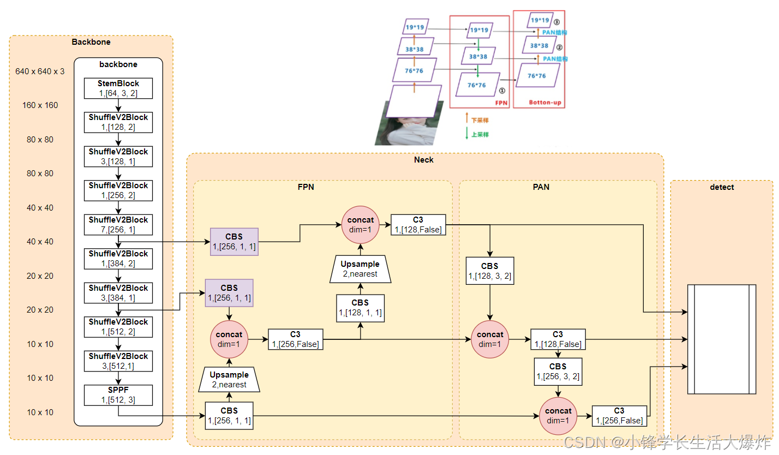
Example-CNNs
Fig1. YOLOv5 Strucuture
Ref:https://blog.csdn.net/sxf1061700625/article/details/124648951
YOLO series:
The YOLO model is perhaps the most popular convolutional neural network deep learning model, with widespread industrial applications. As shown in Figure 1, the v5 model architecture primarily incorporates the Focus structure and CSP structure in the backbone part; the Neck part draws from the FPN+PAN combination design of CSPnet; and the NMS technology is still utilized in the detection head part.
Notes:
Path Aggregation Network
Non-Maximum Suppression

Slide 14
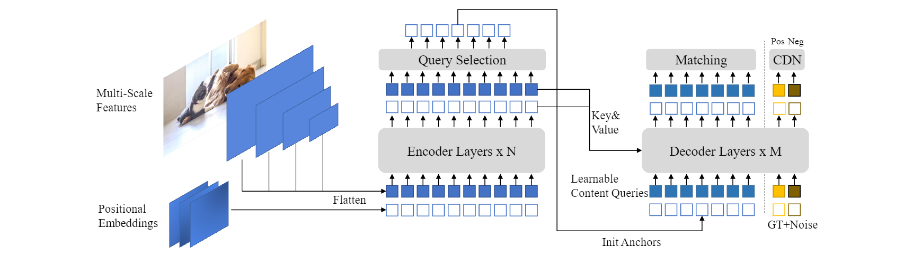
Example-Transformer-based model
Fig.2 DINO Structure
Zhang, Hao, et al. DINO: DETR with Improved DeNoising Anchor Boxes for End-to-End Object Detection.
The popularity of the Transformer model is not only due to the outstanding design of the Attention module itself, but also because of its extremely high scalability --- for example, there are many techniques for query optimization.
DINO is an end-to-end object detection model that improves DETR (DEtection TRansformer) by introducing a contrastive denoising training method. This method adds both positive and negative samples to the same ground truth box, with the less noisy box labeled as positive and the more noisy box labeled as negative. DINO also proposes a mixed query selection method for better initialization of queries, selecting initial anchor boxes as positional queries from the encoder's output while keeping content queries learnable. This encourages the decoder to focus on spatial priors. Finally, DINO introduces a Look Forward Twice scheme to fully utilize box information optimized in later layers to assist in optimizing earlier layers.
Notes:
DINO: DETR with Improved DeNoising Anchor Boxes for End-to-End Object Detection

Slide 15
04. The core design of this work

Slide 16
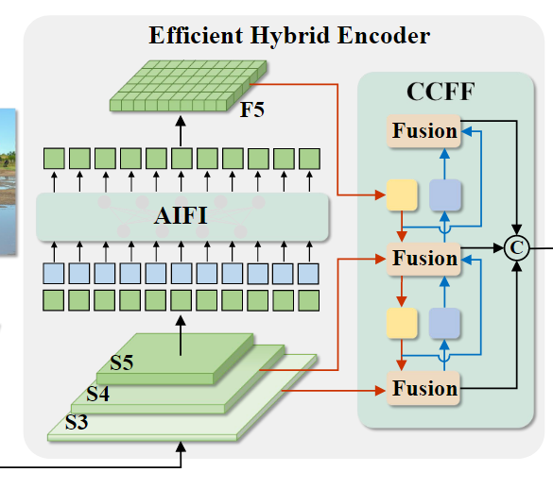
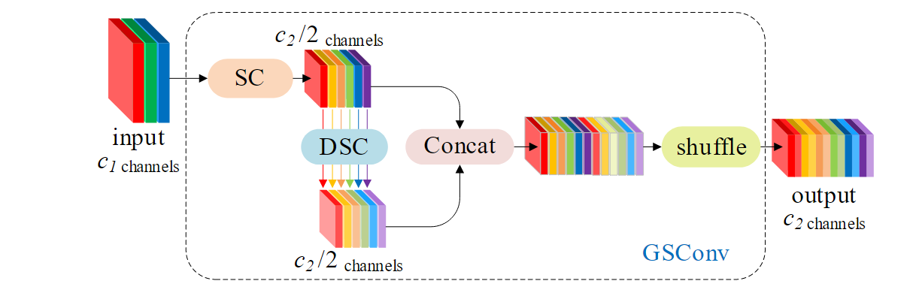
The core of our work
+
01
02
Fig.4 Slimneck CONV Design
Fig.3 RT-DETR Structure

Slide 17
05. Core Code Analysis

Slide 18
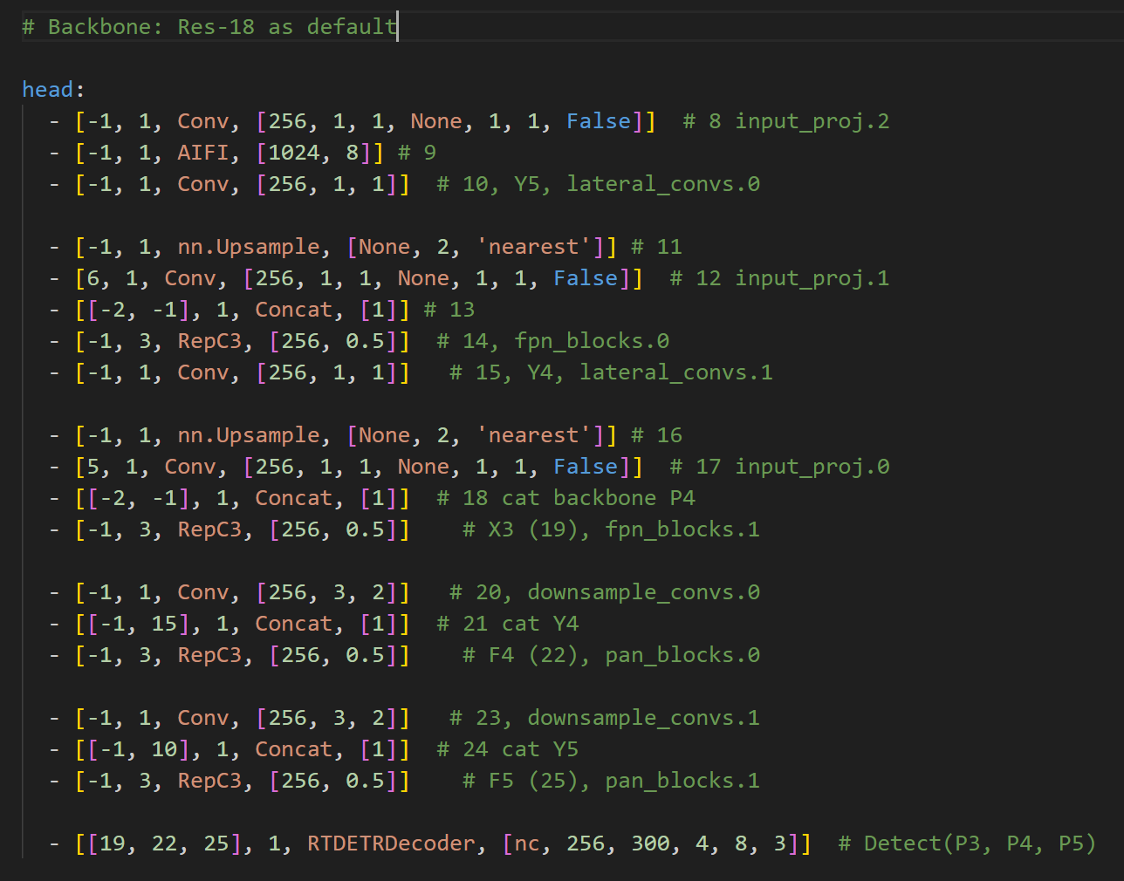
RT-DETR Structure details
AIFI Module
Fusion Design
RTDETRDecoder Module

Slide 19
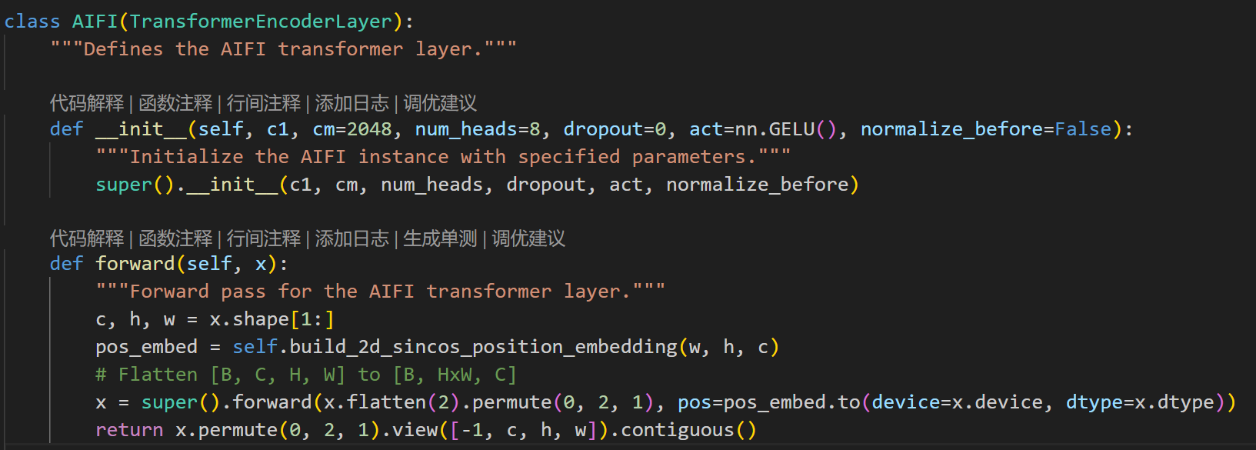
RT-DETR module details
The AIFI module processes multi-scale features to increase inference speed and efficiency. It achieves this through decoupling internal interactions and cross-scale fusion, reducing computational redundancy and allowing the Transformer encoder to process input features more rapidly. This design enables RT-DETR to achieve real-time object detection while maintaining high accuracy.
At the code level, the AIFI module augments the encoder by incorporating 2D sincos positional encodings.
AIFI

Slide 20
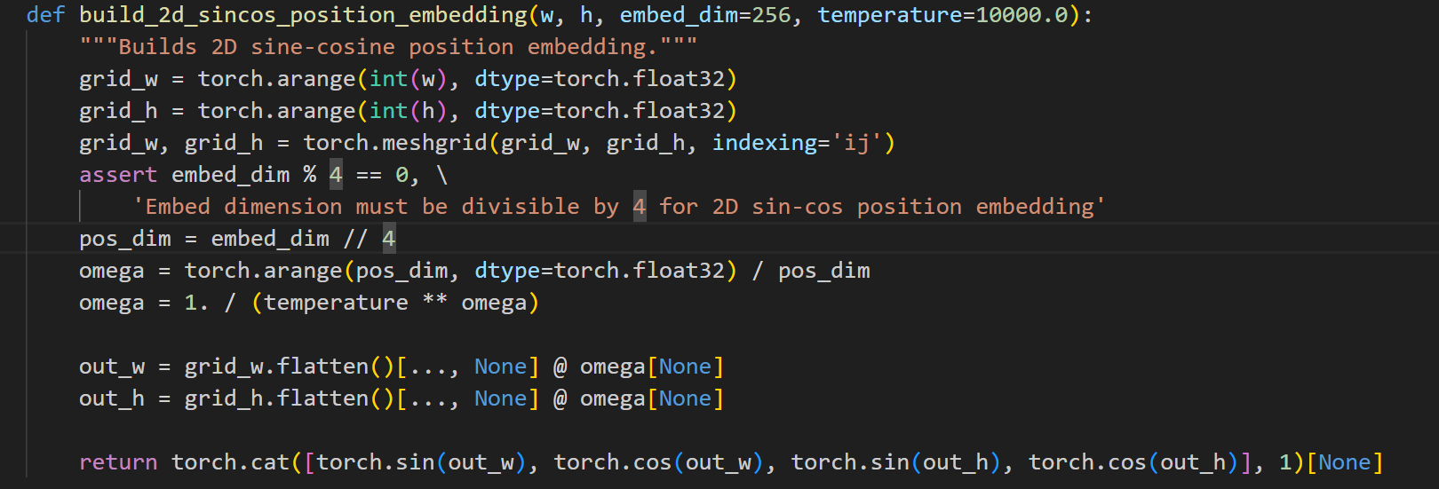
RT-DETR module details
Omega: This controls the frequency of sine/cosine waves for different embedding components.
Temperature: A higher temperature results in slower variation in the embedding with position (lower frequencies).
Grid Creation: grid_w, grid_h; use torch.meshgrid to combine grid_w and grid_h into a 2D grid using torch.meshgrid.
The indexing='ij' argument ensures the correct indexing for image data (y, x).
Output: The function returns a 3D tensor representing the 2D positional encoding.
AIFI

Slide 21
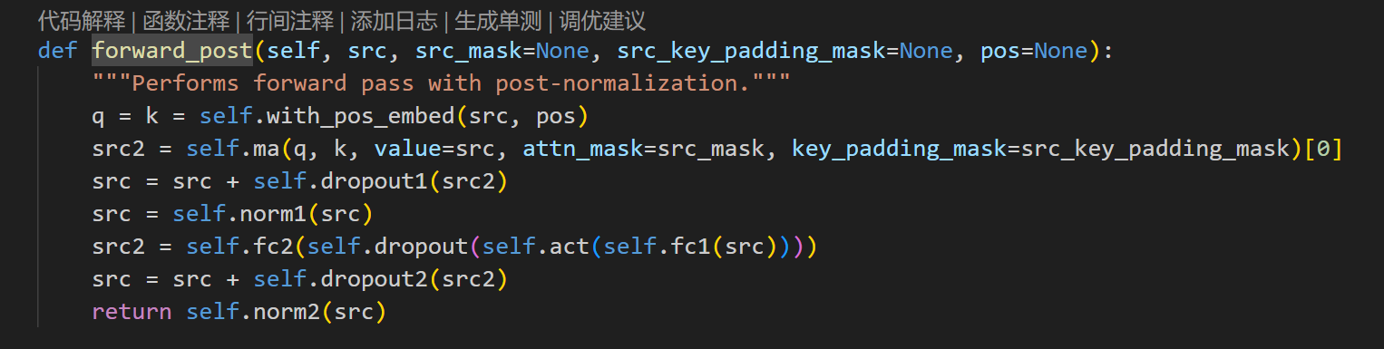
RT-DETR module details
To be simple, the function work with the feature map out from the backbone, apply the position embed get query and key, value is the flattened feature map itself, do a res-connect, followed with LN, go on with FC-Act(GELU)-FC and another res-connect followed with LN. Here we get the output of AIFI module.
Where self.ma means the MultiheadAttention;
Self.fc means the fully connect with nn.Linear method.
AIFI-Transformer_base_encoder.forward()

Slide 22
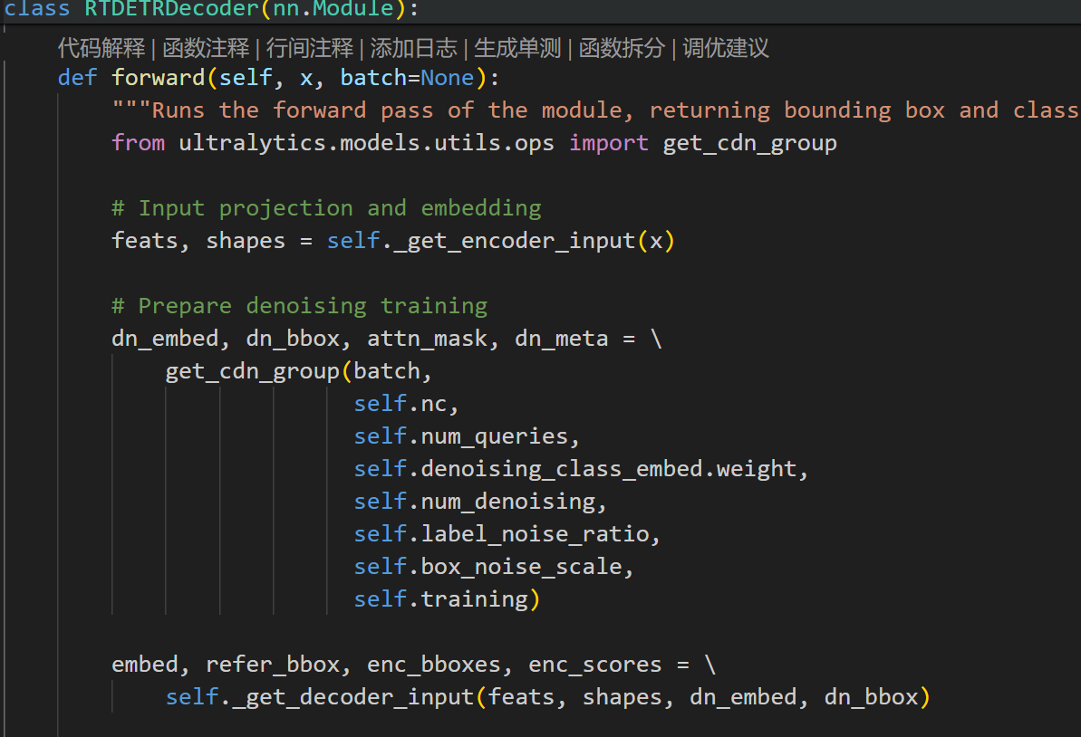
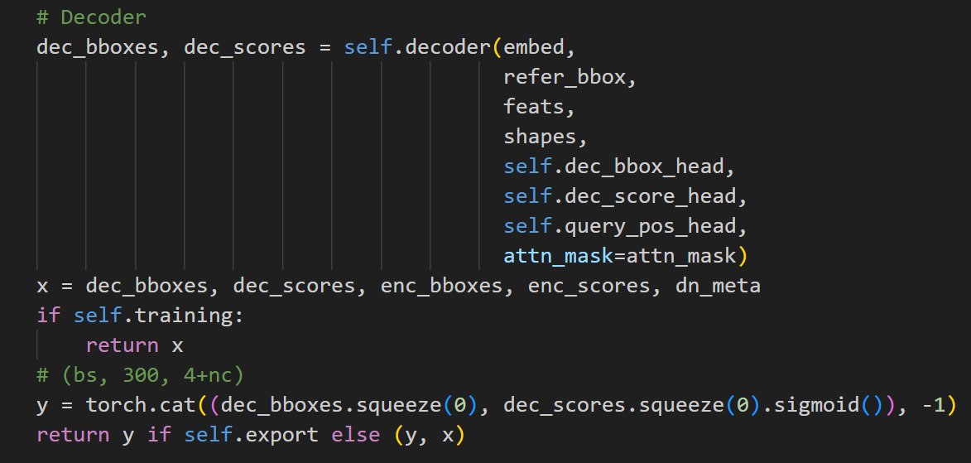
RT-DETR module details
RTDETRDecoder utilizes Transformer architecture along with deformable convolutions to predict bounding boxes and class labels for objects in an image. It integrates features from multiple layers and runs through a series of Transformer decoder layers to output the final predictions.
The most important part of this decoder’s code is ‘cdn’ parameter and ‘decoder’ parameter.
RTDETRDecoder
Notes:
To be simple, I skip the figure of init self params, just explain the forward pipeline.

Slide 23
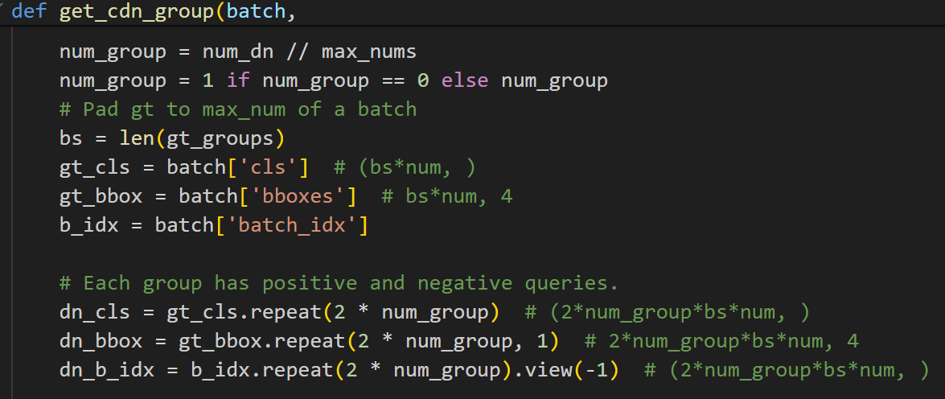
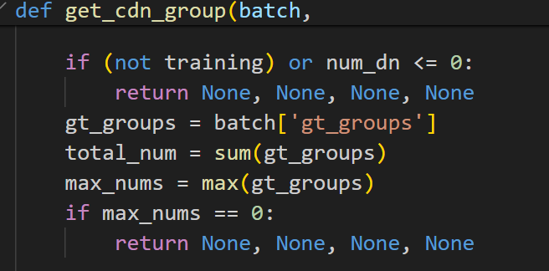
RT-DETR module details- denoising training
This module defines a function named `get_cdn_group`, which is designed to create training groups for contrastive denoising training. The function generates positive and negative samples from the ground truth (gt) labels. By adding noise to the class labels and bounding box coordinates, and returning the modified labels, bounding boxes, attention masks, and metadata, this function supports denoising contrastive learning during the training process.
The raw denoising training method comes from the paper: ‘DN-DETR
’, the method here ‘CDN’ means Constructive DeNoising training.
RTDETRDecoder-cdn
First part, this denoising module only work for training part.
Calculate the total number of true labels and the maximum number in each batch. Then, compute the number of denoising groups based on the maximum number and the number of denoising operations.
Notes:
Calculate the total number of true labels and the maximum number in each batch, then compute the number of denoising groups based on the maximum number and the denoising quantity. Additionally, pad the true labels to the maximum number in the batch: adjust gt_cls, gt_bbox, and b_idx to match the maximum number in the batch.

Slide 24
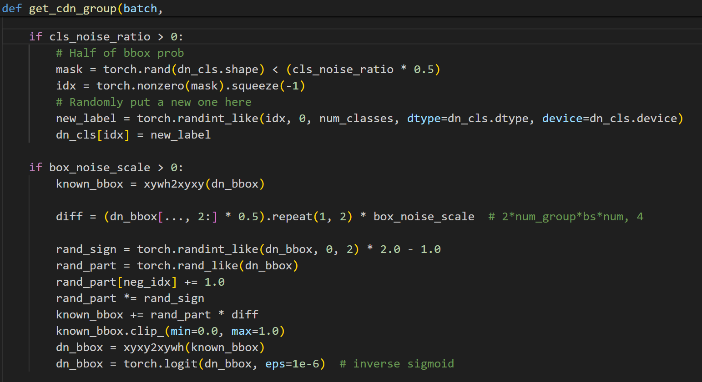
RT-DETR module details- denoising training
Step 3: Generate Positive and Negative Samples: Generate class labels and bounding boxes for positive and negative samples through repetition and indexing operations.
Step 4: Adding Noise:
If the cls_noise_ratio is greater than 0, noise is added to the class labels.
If the box_noise_scale is greater than 0, noise is added to the bounding box coordinates, which involves converting the bounding boxes from xywh format to xyxy format, adding noise, converting them back to xywh format, and applying the inverse sigmoid function.
Notes:
Step 3: Generate Positive and Negative Samples: Generate class labels and bounding boxes for positive and negative samples through repetition and indexing operations.
Step 4: Add Noise: If the cls_noise_ratio is greater than 0, add noise to the class labels. If the box_noise_scale is greater than 0, add noise to the bounding box coordinates, including converting the bounding box from xywh format to xyxy format, adding noise, and then converting back to xywh format, followed by applying the inverse sigmoid function.

Slide 25
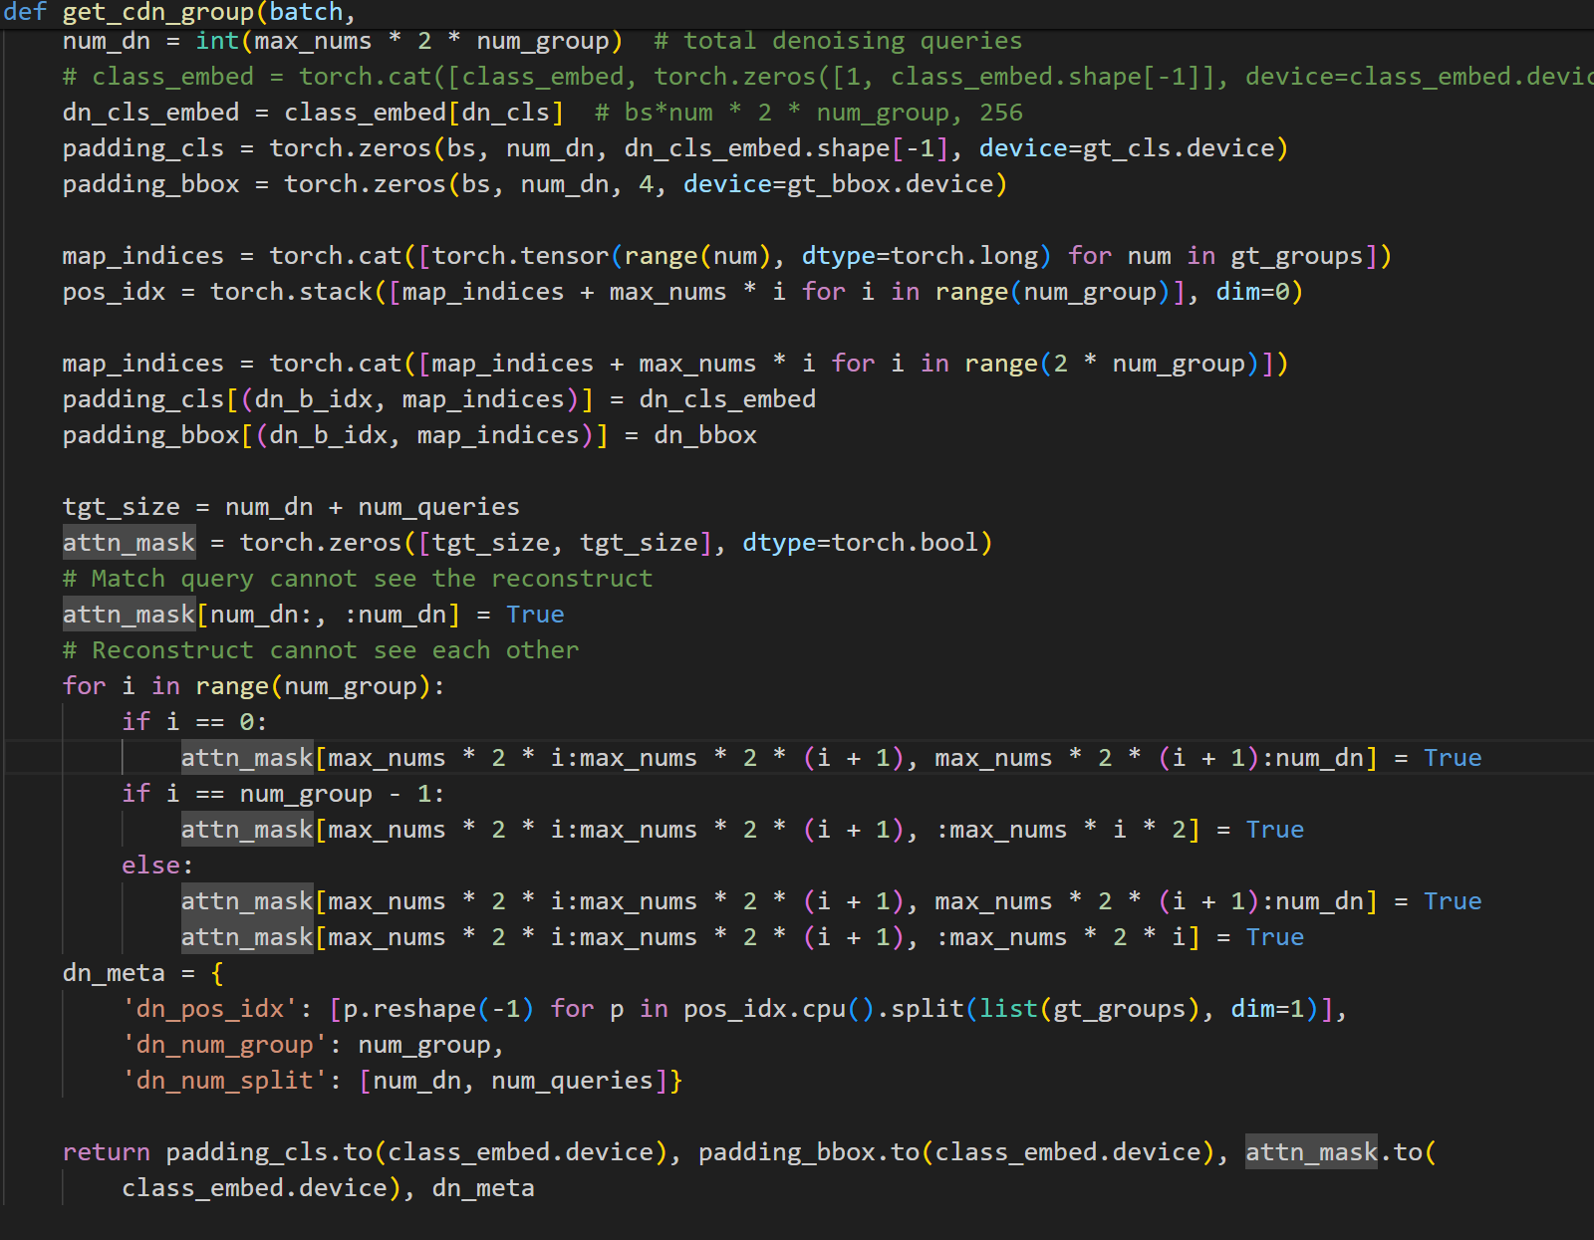
RT-DETR module details- denoising training
The next key step: generating an attention mask, which involves creating an attention mask to ensure that the queries cannot see the reconstructed samples, and that the reconstructed samples cannot see each other.
Prepare and return modified class embeddings, bounding boxes, attention mask, and meta-information based on computed results and parameters.
Notes:
The next key step: generating an attention mask, which involves creating an attention mask to ensure that the queries cannot see the reconstructed samples, and that the reconstructed samples cannot see each other. Finally, based on the computed results and parameters, prepare and return the modified class embeddings, bounding boxes, attention mask, and meta-information.

Slide 26
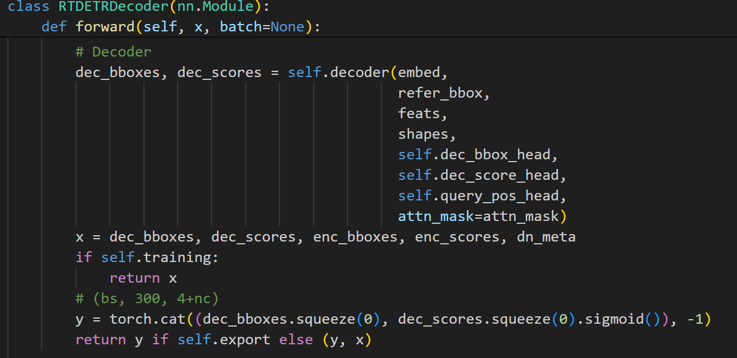
RT-DETR module details-DeformableTransformerDecoder
RTDETRDecoder utilizes Transformer architecture along with deformable convolutions to predict bounding boxes and class labels for objects in an image. It integrates features from multiple layers and runs through a series of Transformer decoder layers to output the final predictions.
The most important part of this decoder’s code is ‘cdn’ parameter and ‘decoder’ parameter.
RTDETRDecoder
Notes:
To be simple, I skip the figure of init self params, just explain the forward pipeline.

Slide 27
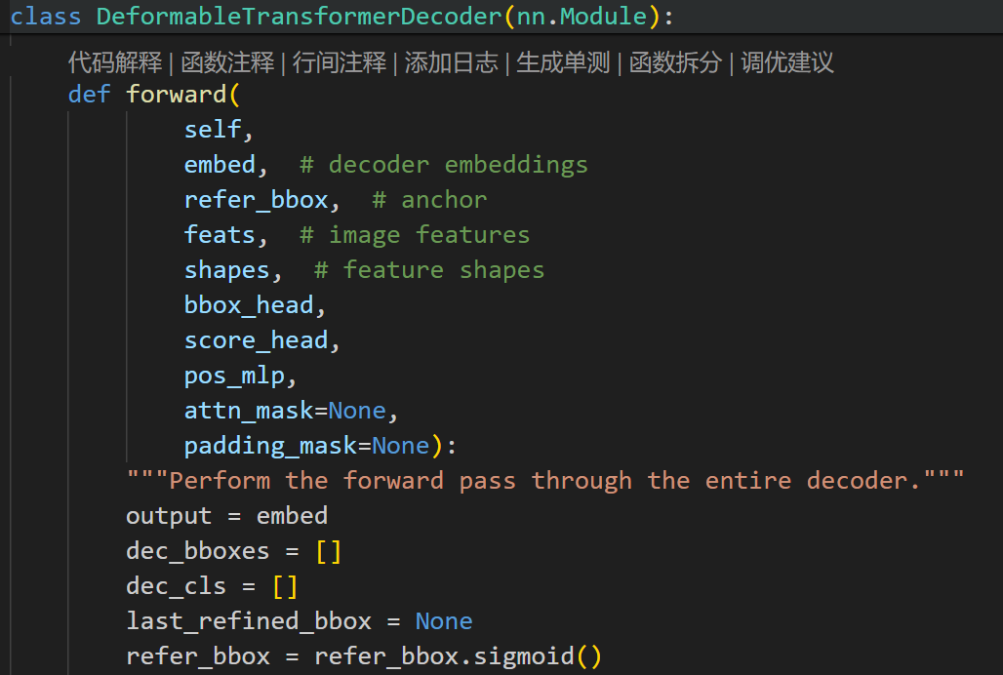
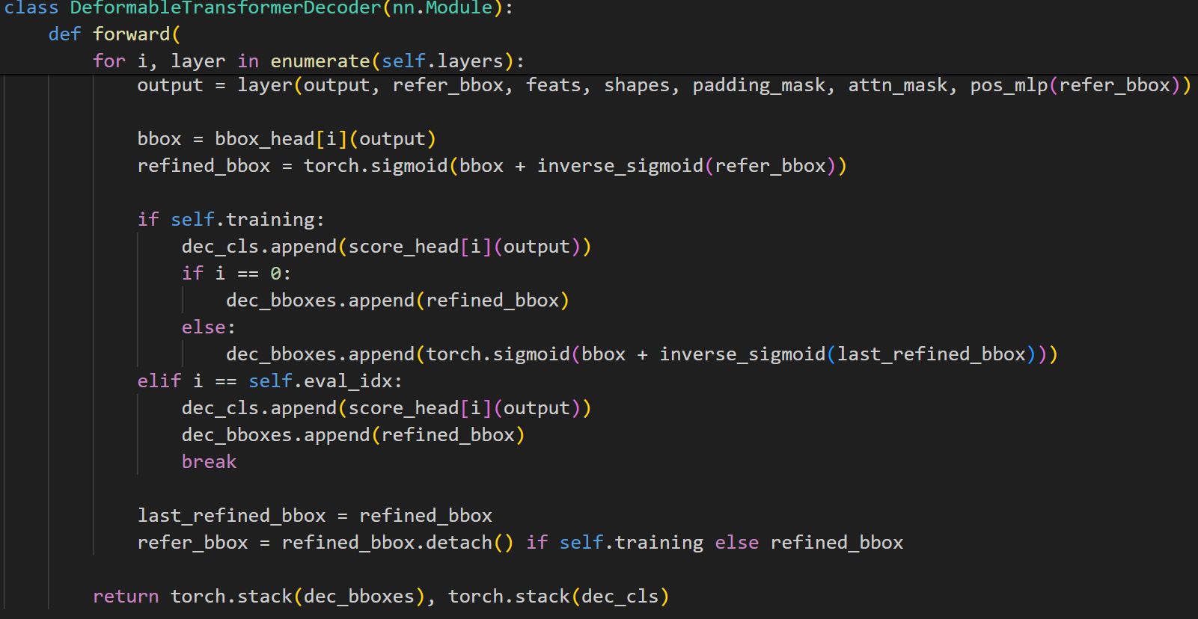
RT-DETR module details-DeformableTransformerDecoder
1. Initialize the output size as embedding’s and create an empty list to store the decoded bounding boxes and class scores.
2. Apply the Sigmoid function to `refer_bbox`, constraining its values within the range (0, 1).
3. Iterate through the decoder layers:
Pass the current layer's output, reference bounding boxes, image features to the current layer and obtain the updated output.
Use `bbox_head` to predict new bounding boxes and refine them by adding them to the inverse Sigmoid of the reference bounding boxes.
in training mode, predict class scores for each layer and selectively store the refined bounding boxes based on whether it is the first layer or a subsequent layer
Notes:
The output is initialized as an embedding and a list is created to store the decoded bounding boxes and class scores. The Sigmoid function is applied to `refer_bbox`, and the decoder layers are iterated through. For each layer, the current output, reference bounding boxes, and other inputs are passed to the layer to obtain an updated output. The `bbox_head` predicts new bounding boxes which are added to the inverse Sigmoid of the reference boxes to refine them. In training mode, class scores are predicted and selectively stored based on the layer index. In evaluation mode, the class scores and bounding boxes are stored when the current layer index equals `eval_idx` and the loop is exited. The last refined bounding boxes and reference boxes (in training mode, with gradients detached) are updated. The function returns the stacked decoded bounding boxes and class scores.

Slide 28
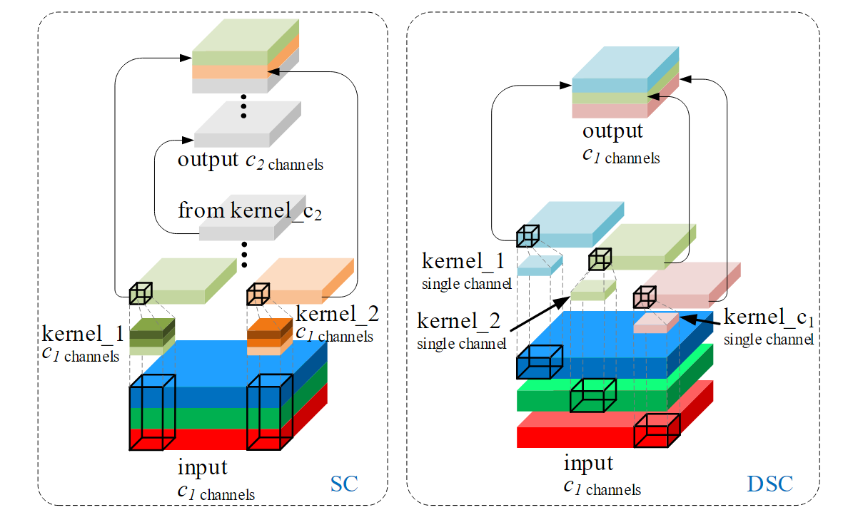
Slimneck-GSConvolution details
Channel – dense Conv
Channel – sparse Conv
Compared to channel-sparse convolution, channel-dense convolution does not completely sever the connections between channels; instead, it strives to preserve these connections as much as possible. Channel-sparse convolution, in its computational process, independently processes information for each channel, thereby weakening the interaction of information between channels.
Previous works mostly utilize depth-wise separable convolution (DSC) to reduce parameters and floating-point operations (FLOPs, the number of multiply-adds). The lightweight effect of DSC is clear, see Appendix, but its disadvantages are also evident: the channels information of input images is separated in the calculation process.
A simple go-over about the SC and DSC

Slide 29
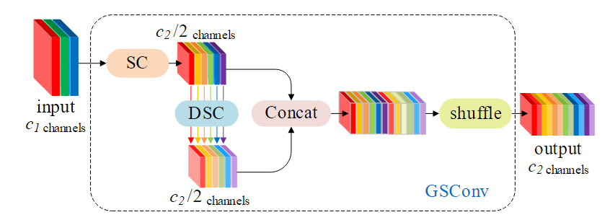
Slimneck-GSConvolution details
GSConv achieves near-standard convolution representation capabilities through the largely preserved hidden connections between channels. It uses a Shuffle operation to mix features generated by SC into the output of DSC, enabling the exchange of local feature information across different channels without additional computation. This process, which incorporates a DSC layer and a Shuffle operation, enhances the model's nonlinear expressive capabilities. GSConv performs exceptionally well in lightweight models due to these capabilities. It is primarily used in the model's Neck section to accelerate inference speed and maintain accuracy. At this stage, the feature maps have become sufficiently elongated.
GSConv Design

Slide 30
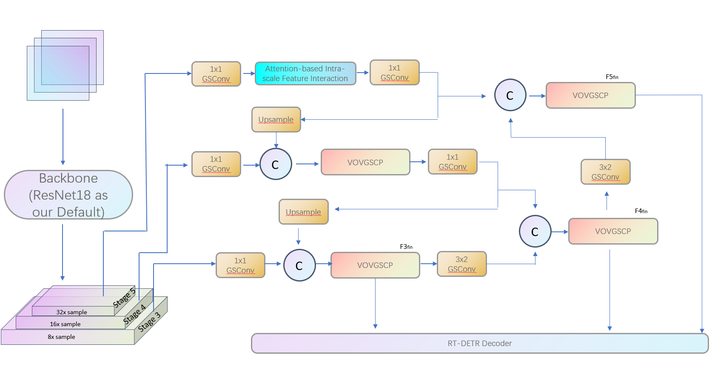
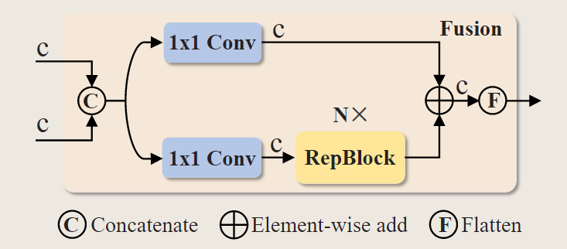

Slide 31
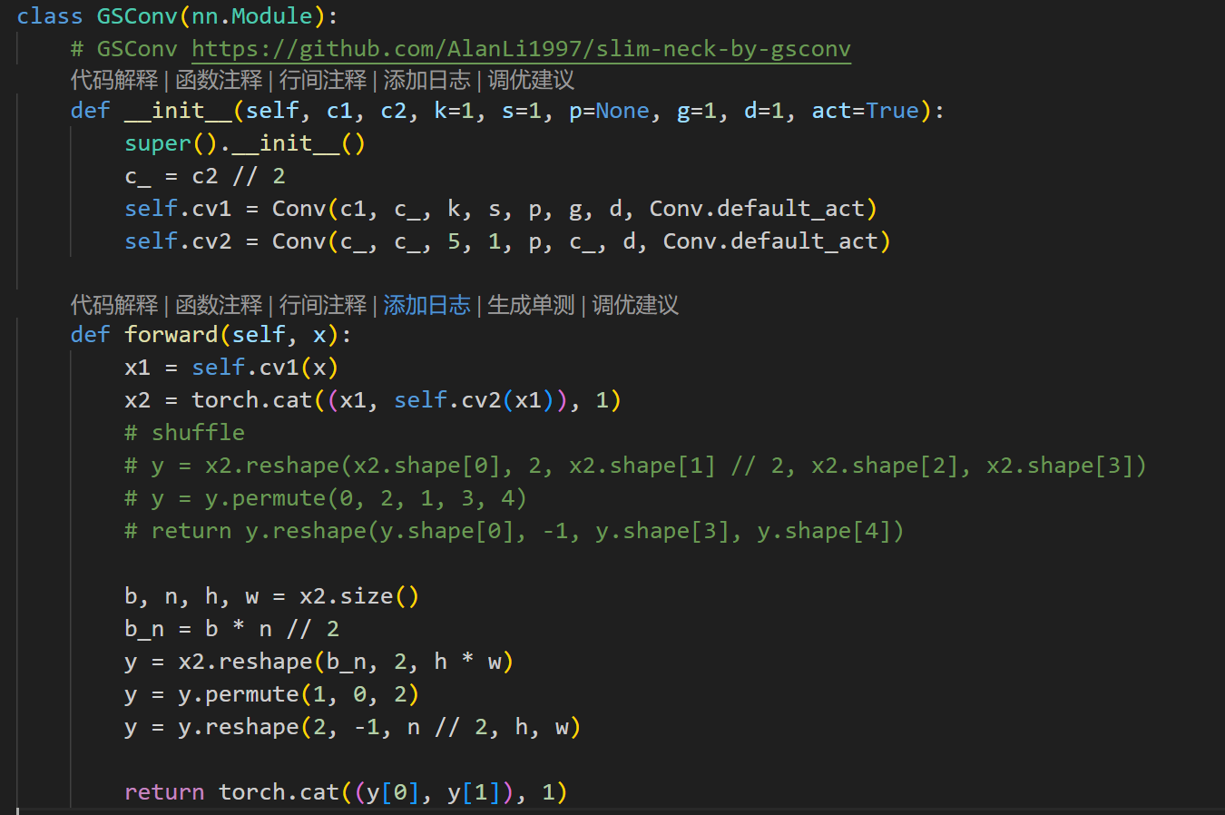
Slimneck-GSConvolution details
In essence, GSConv mitigates accuracy loss from complete DSC operation by selectively applying dense convolution to half of the feature channels and sparse convolution to the other half. The two sets of features are then shuffled and concatenated to form the final output features.
GSConv Design in codes

Slide 32
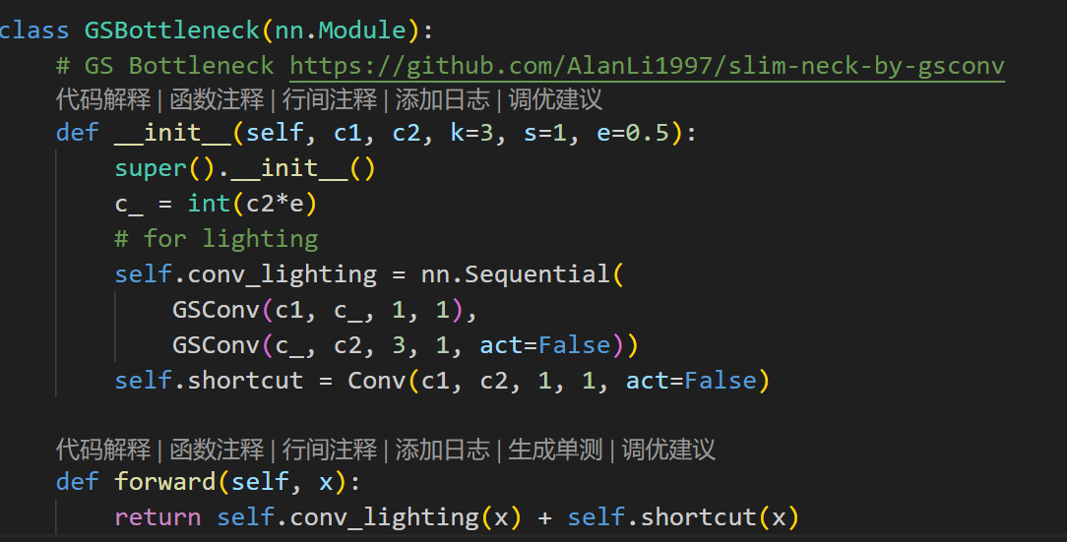
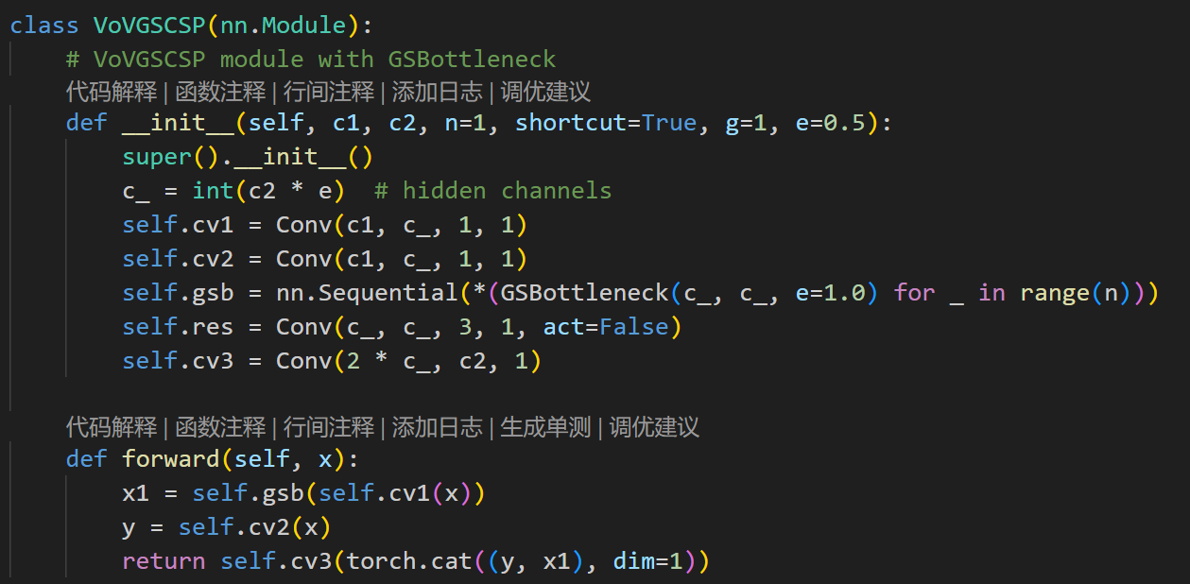
Slimneck-GSConvolution details
GSBottleneck and VoVGSCSP are simple modules that are stacked on top of GSConv. We will use VoVGSCSP instead of RepC3(YOLO series) in the cfg.
GSConv Design in codes
Notes:
GSBottleneck and VoVGSCSP are simple

Slide 33
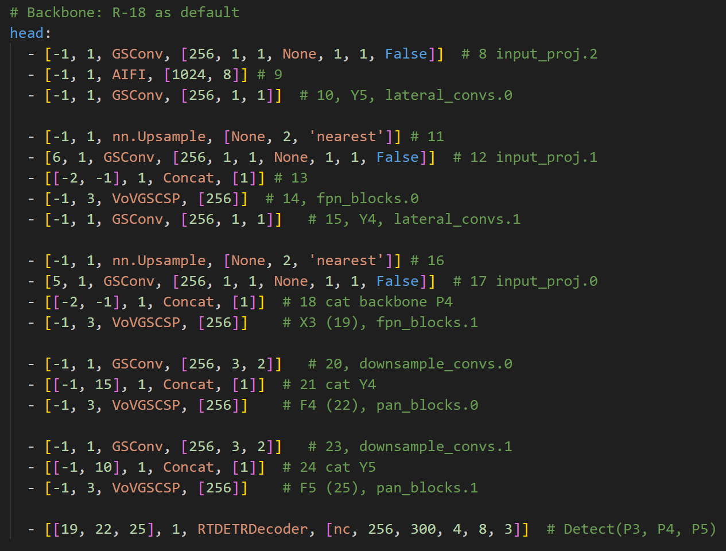
The Final structure of this work
Use the refined Conv module ‘GSConv’ and bottleneck block ‘VoVGSCSP’ instead of basic Conv and RepC3 module.

Slide 34
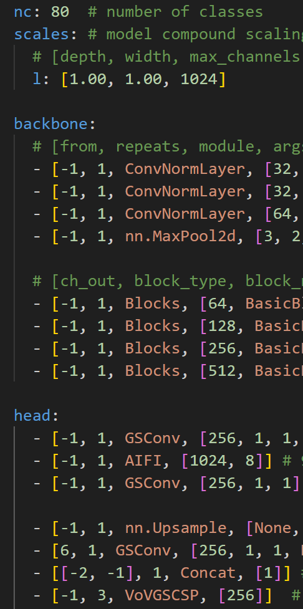
More details beyond the model itself-ultralytics structure
About cfg file, in ultralytics’ structure the config file compiled with ‘.yaml’ format. The params are defined by numbers or strings. We should set a part of dataset setting and the full model structure here. But notice that the dataset setting will supposed to be overcovered by specific dataset’s config file later.
Next, why these strings work to construct the whole model? Let’s refer to the task.py file. PATH in ‘ultralytics/nn/task.py’. In the function ‘parse_model’ defines the method of transfer these str in config file into pytorch block instance.
A small question, why the raw ‘Block’ function need to be given 5 parameters but in the config file we just give 4 params?
Notes:
Somemore details: YOLOs often use SGD optimizer, DETR use AdamW
But in the experiments here we all apply AdamW optimizer as ultralytic’s default

Slide 35
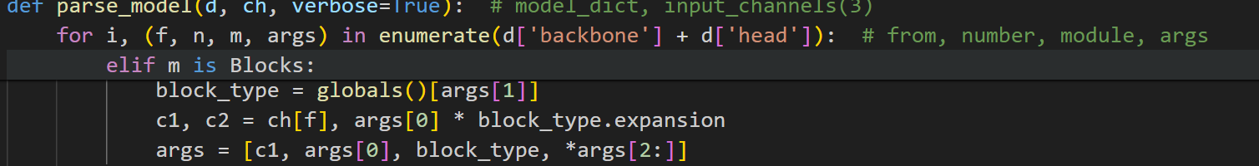
More details beyond the model itself-ultralytics’ structure
A small question, why the raw ‘Block’ function need to be given 5 parameters but in the config file we just give 4 params?
Just keep in mind that this question raised from the config file. So check the ‘parse_model’ function again. Actually all of the setting considering config files are inside this function. As we can see in the above case, we actually define the ‘channel_input’ parameter as the output from the layer before. So the first parameter ‘ch_in’ inside the ‘Blocks’ function don’t need to be given in the config file.
Notes:
Moreover, about the dataset config file, just remember we need to set the data path, give the class names. But note ultralytics always accept the YOLO format dataset, don’t forget to transfer your dataset into YOLO format.

Slide 36
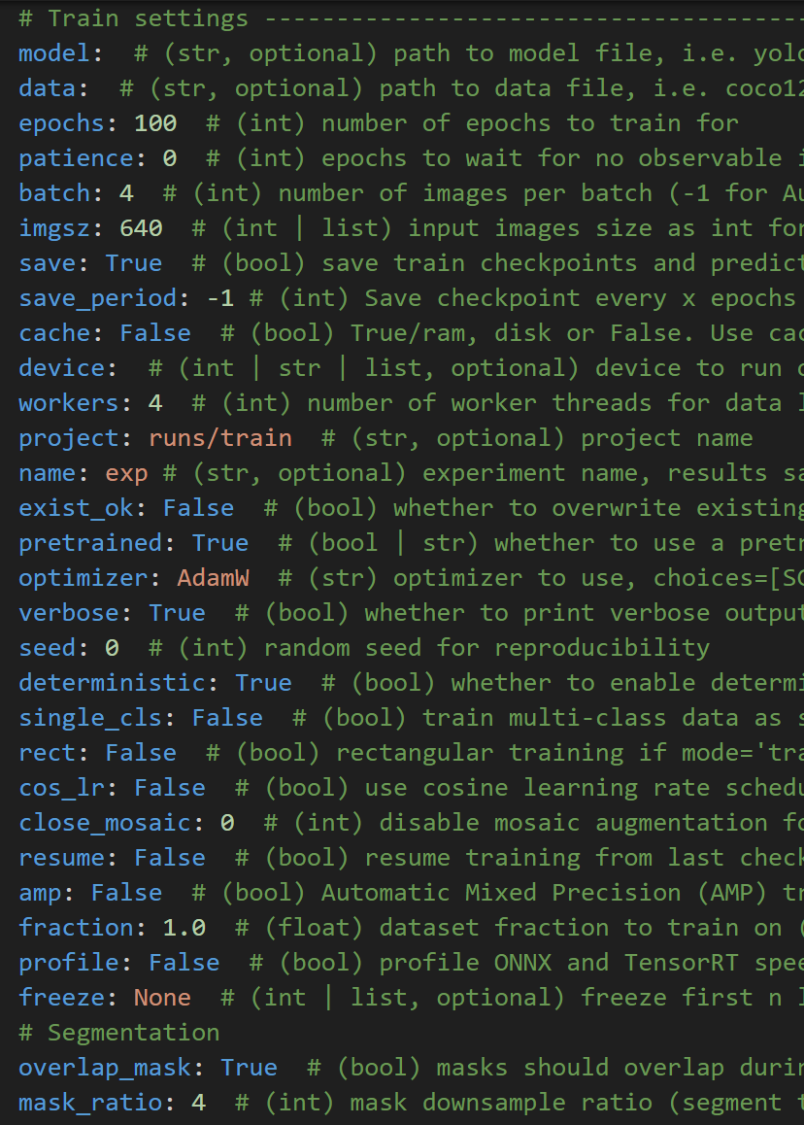
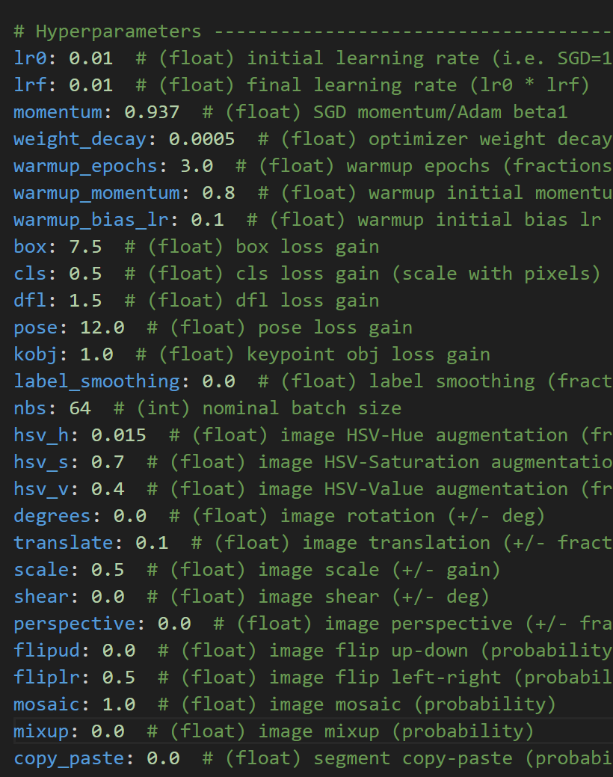
More details beyond the model itself-ultralytics structure
Notes:
Epoch actually we apply is about 150 epochs(we resend the parameter in the training script) others keep the default setting(but somehow different from ultralytic’s official one)

Slide 37
06.Experiments

Slide 38
Environment
Except the YOLOv5s, all the other models conducted on the environment below:
HardWare:
CPU: 12 vCPU Intel(R) Xeon(R) Platinum 8352V CPU @ 2.10GHz
GPU: one RTX 4090(24GB) GPU
SoftWare:
The vision of pytorch is 1.11.0+cu113 and torchvision is 0.12.0+cu113.
Ultralytics with version v8.0.201, MMCV: 2.00rc4, MMDet: 3.2.0, MMEngine: 0.8.4

Slide 39
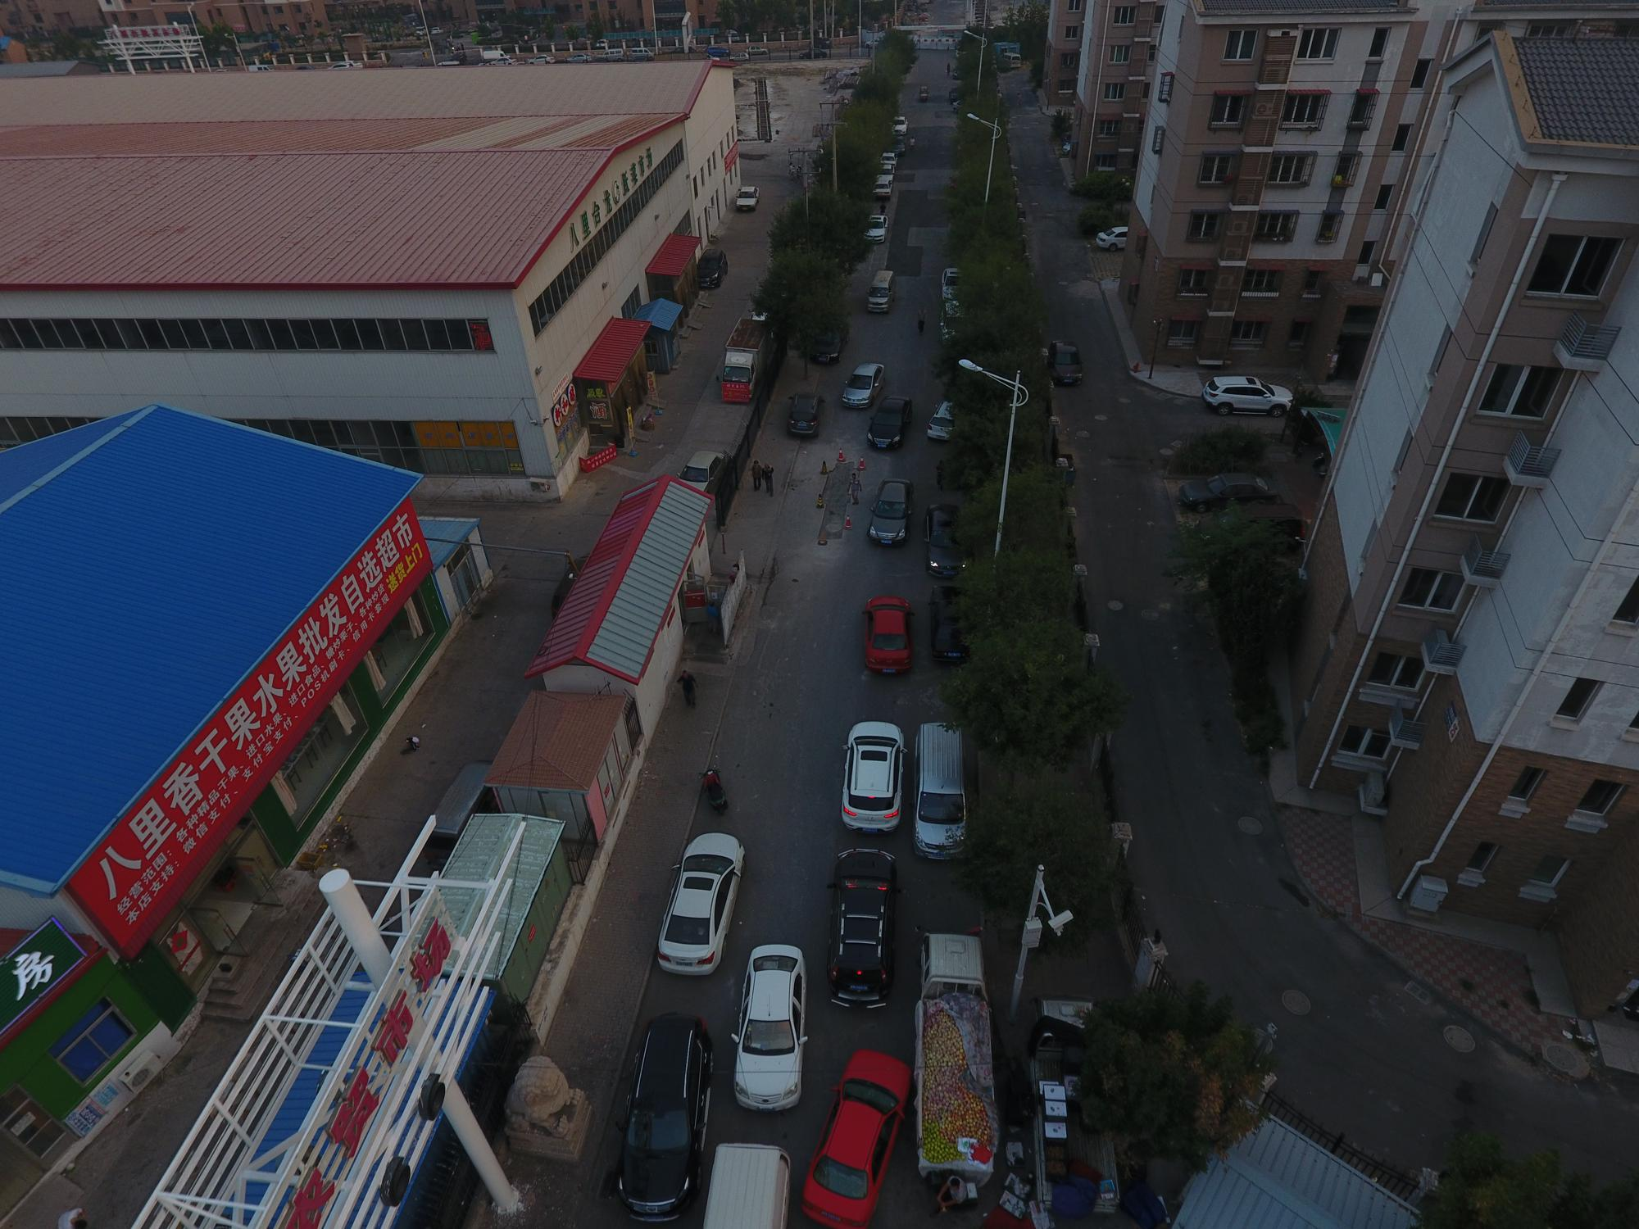
Dataset
All the models are trained and tested on the VisDrone dataset. VisDrone is a dataset captured by various drone-mounted cameras from urban and country constitutions, consisting of 10209 high resolution(2000x1500) images with 12 object categories, here only accept the 10 over 12 real labels[1].
VisDrone is a large-scale benchmark with carefully annotated ground-truth for various important computer vision tasks, to make vision meet drones. The dataset is divided and 9188 images are used for training, 1020 images for validation and test in the experiments below.
[1]: 10 classes: pedestrian, people, bicycle, car, van, truck, tricycle, awning-tricycle, bus, motor Except ignored regions and other.

Slide 40
Experiments
Advantages
Lightweight
53.6GFLOPs,0.1939e params
Higher precision
Achieve 0.46964 mAP50(B), 0.28919 mAP50-95(B) on VisDrone.
Enhancing Scalability
The introduction of the Transformer concept has added numerous extension dimensions to subsequent model improvements and is also more suitable for integration with the design of models in other fields.

Slide 41
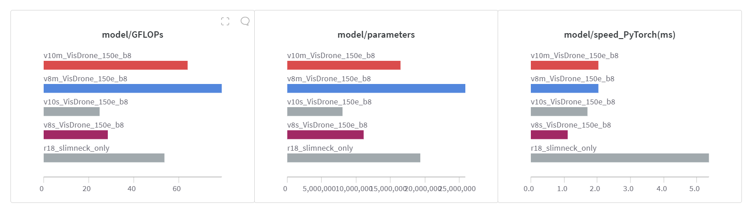
Experiments
Advantages
Lightweight
53.6GFLOPs,0.1939e params, beats middle size of YOLOs.

Slide 42
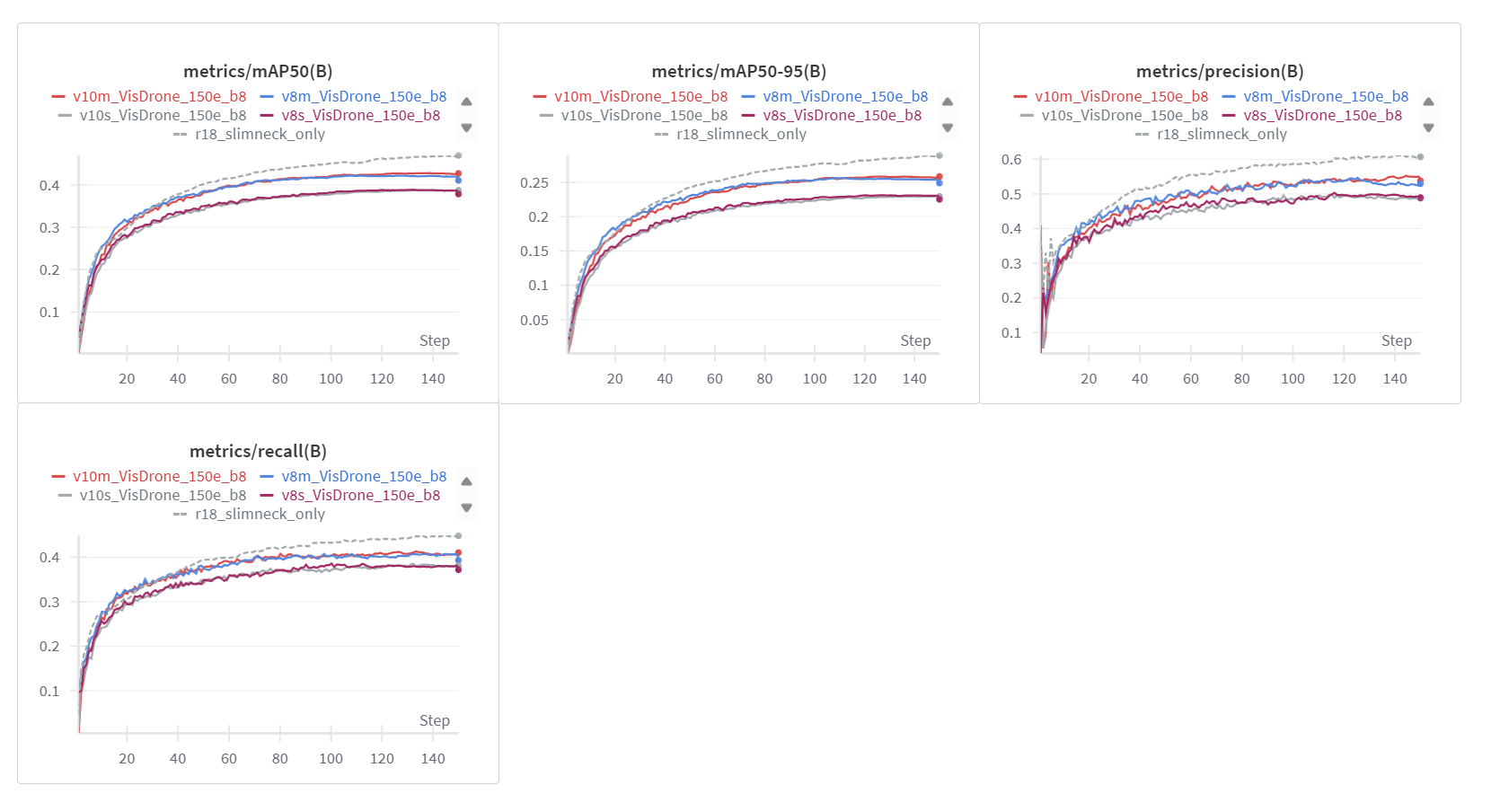
Experiments
Advantages
Higher precision
Achieve 0.46964 mAP50(B), 0.28919 mAP50-95(B) on VisDrone. It surpasses the medium-sized YOLOs by more than 6 percentage points in mean average precision at IoU:50.

Slide 43
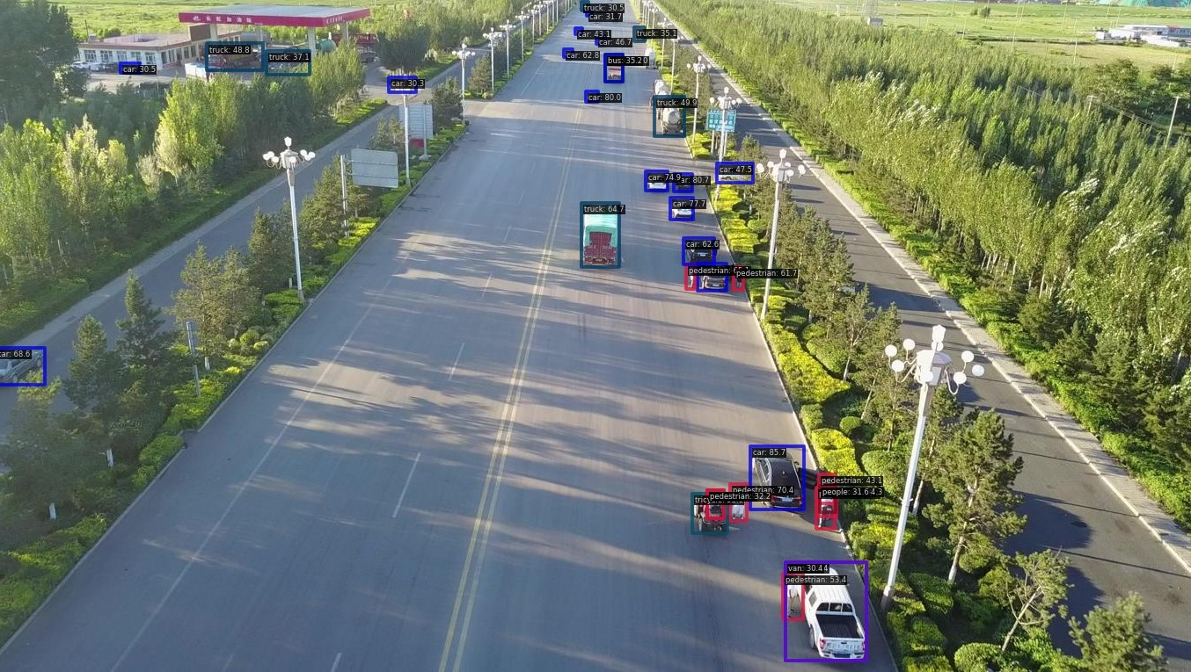
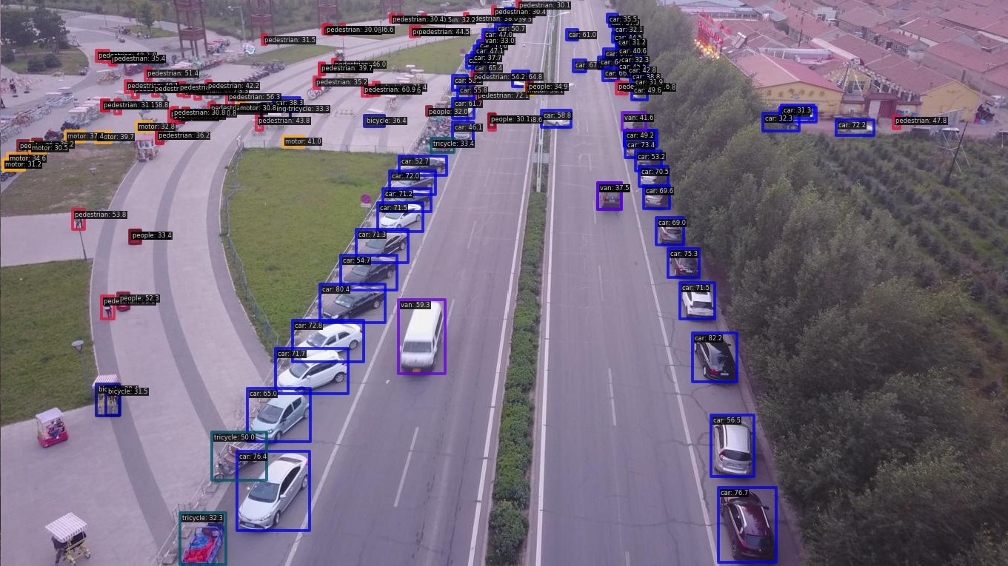
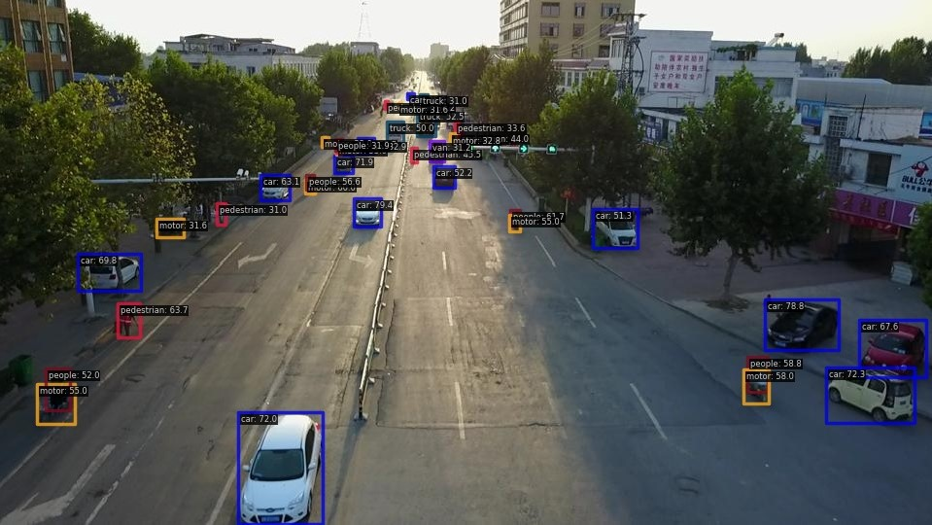
Experiments
Visual Results

Slide 44
07.Conclusion

Slide 45
Conclusion
In this work, we compare the difference between GSConv-RTDETR with YOLOs. We digged further into the ultralytics library and practice more about constructe a combined model and analysis the performance between models.

Slide 46
Thank You
Yiren QIU
Ghous Iqbal

